Slide 1


Team:
DROP
ELTRMG
Sustainability challenge
JunctionX Budapest Hackathon - 2023
Collective drops, sustainable waves
Ábel Németh
Gergely Hüvös
Gábor Kismárton
Tamás Molnár
November 26th, 2023
Vojtech Vasut

Slide 2

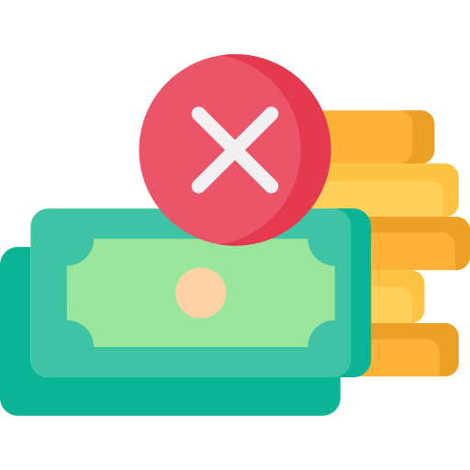




To motivate people towards sustainability, we need to present it to them differently.
DROP
People aren’t chasing sustainable habits, because….
…they don’t know enough
…it is boring
...there are no incentives
Give them advice!
Gamify it!
Reward them!
Drop application will have all these features!
DROP

Slide 3
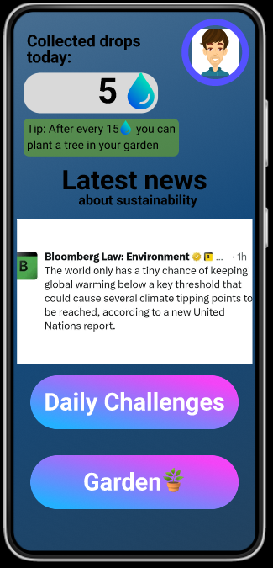

Drop will offer blog posts and other educational contents
DROP
DROP
Give them advice!
Gamify it!
Reward them!
Blog and educational content

Slide 4
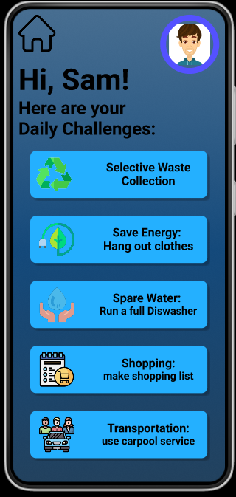

Drop will educate by use with the personalized challanges
DROP
DROP
Give them advice!
Gamify it!
Reward them!
Blog and educational content
Personalised challenges and recommendations

Slide 5
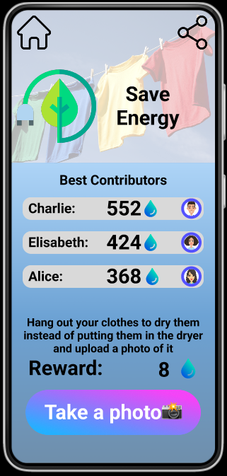

Users can collect “Drops” after making a contribution
DROP
DROP
c
Give them advice!
Gamify it!
Reward them!
Blog and educational content
Earning “Drops” as a reward for environmental acts
Personalised challenges and recommendations

Slide 6

Virtual trees purchased for “Drops” will show they commitment
DROP
DROP
c
Give them advice!
Gamify it!
Reward them!
Blog and educational content
Earning “Drops” as a reward for environmental acts
Personalised challenges and recommendations
Growing a virtual forest, collecting streaks and badges

Slide 7
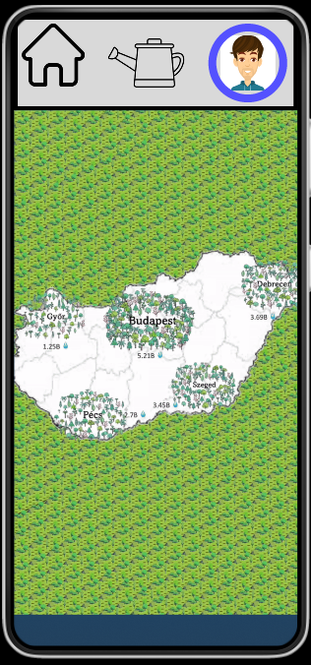

They will see the big picture: how cities compare
DROP
DROP
c
Give them advice!
Gamify it!
Reward them!
Blog and educational content
Earning “Drops” as a reward for environmental acts
Personalised challenges and recommendations
Growing a virtual forest, collecting streaks and badges
Seeing how cities preforming and competing

Slide 8
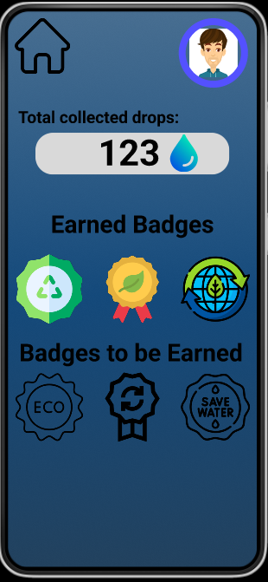
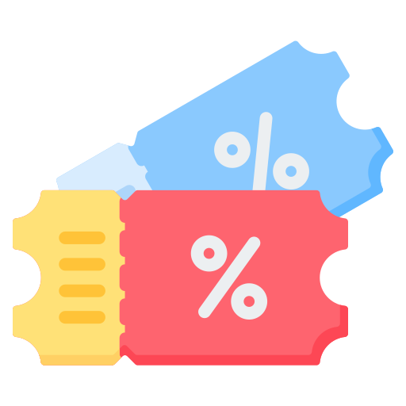
They can earn badges and get coupons as incentives
DROP
DROP
c
Give them advice!
Gamify it!
Reward them!
Blog and educational content
Earning “Drops” as a reward for environmental acts
Getting discounts and coupons for your progress
Personalised challenges and recommendations
Growing a virtual forest, collecting streaks and badges
Seeing how cities preforming and competing

Slide 9
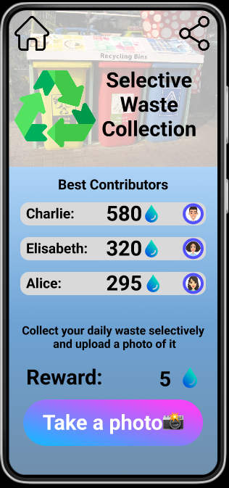

Pictures or geo location will validate their claims
DROP
DROP
c
Give them advice!
Gamify it!
Reward them!
Blog and educational content
Earning “Drops” as a reward for environmental acts
Getting discounts and coupons for your progress
Personalised challenges and recommendations
Growing a virtual forest, collecting streaks and badges
Validation bans those who will try to cheat
Seeing how cities preforming and competing

Slide 10
The app has various features
DROP
DROP
Give them advice!
Gamify it!
Reward them!
Blog and educational content
Earning “Drops” as a reward for environmental acts
Getting discounts and coupons for your progress
Personalised challenges and recommendations
Growing a virtual forest, collecting streaks and badges
Validation bans those who will try to cheat
Seeing how cities preforming and competing

Slide 11



The app provides personalised tips to best suit the individual’s case
DROP
Completing a short quiz on their habits.
Users are segmented based on
demographic, psychographic, and behavioral dimensions.
This allows the campaign to target a diverse audience, while still tailoring the content to the pain points of individuals.

Slide 12



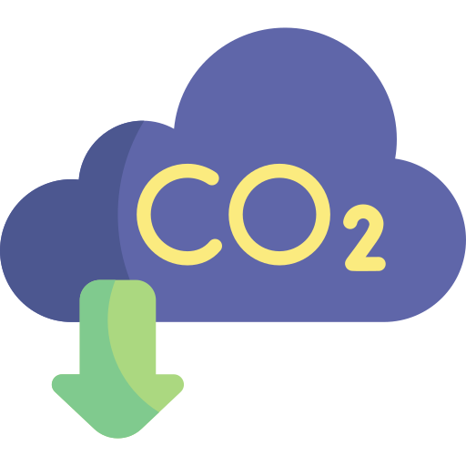
Impact should be measured not only at an individual level but also at a community level.
DROP
For a household
For a bigger city
(with 40.000 users)
In a year:
97
Billions liter of water saved yearly
liters of water a day
1.46
2%
Reduction in electricity usage
1.7
Million kWh saved electricity
Tonnes less of CO2/person/year
3.6-10+
Million tones reduced CO2
1.6

Slide 13

The intangibility of the project means that it is not tied to a single country.
DROP
Steps to internationalize:
Cross-cultural and local experts adjust the content
Translation of the content
The project is easily scalable after a working pilot project.
Negotiating with new business partners
Local marketing campaign
Community involvement and bug fixing

Slide 14


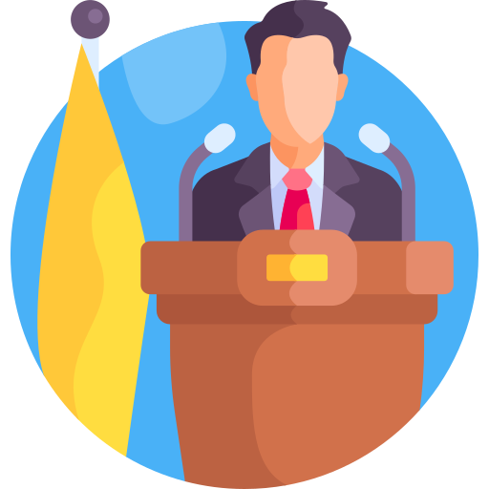

The project would be funded by advertising revenue and corporate or government sponsors.
DROP
A subscription-based business model would NOT be appropriate for such an application.
Instead, we can get support from:
Users
Governments, municipalities
Business partners
Paying for premium skins
Promote the app
Sponsorships
Revenue via ads
Tenders for the green cities
Ensuring the reward system
Motive:
Motive:
Motive:
Free, user-friendly application
Social responsibility
PR boost, ESG

Slide 15

Thank you for your attention!

Slide 16
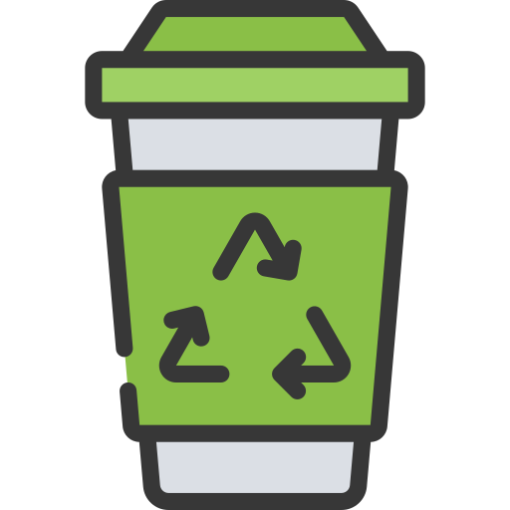
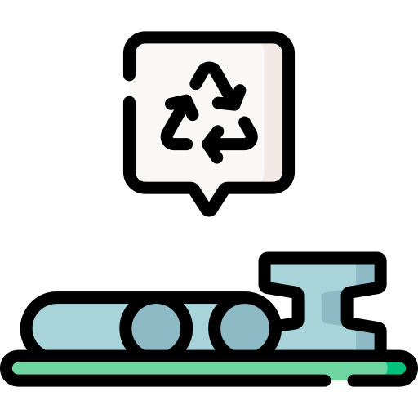


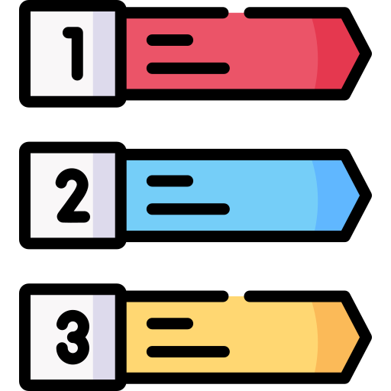





Taking action for sustainability is much more than recycling
DROP
Food/Drink
Shopping
Have your own reusable cup
Compost
Use reusable bags when shopping
Don't use plastic plates
Grow your own vegetables
Drink tap water
Use Munch to save food
If you need something new, try to buy recycled stuff, for example on Craigslist.
Only buy what you really need - make a shopping list to help you stick to it.
Don't buy plastic bottles and choose glass or metal cans that you know will be reused.

Slide 17
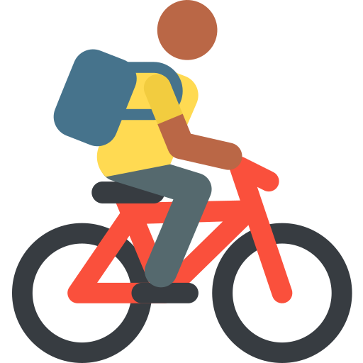
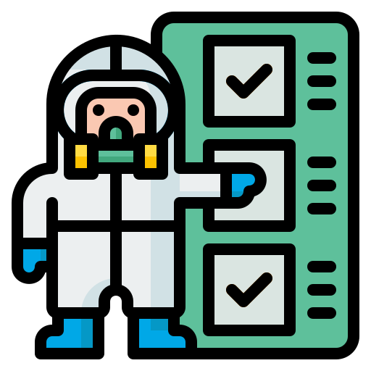
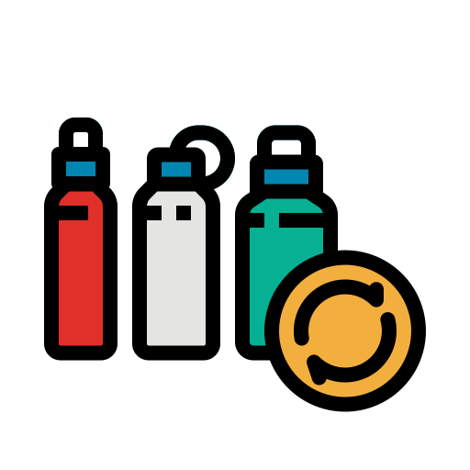



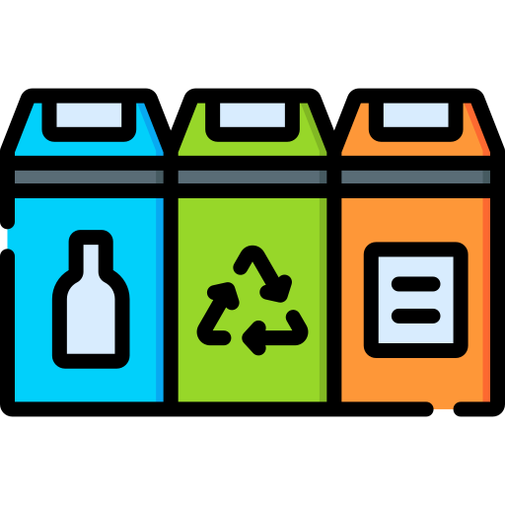

Taking action for sustainability is much more than recycling
DROP
Transportation
Waste
Haz Mat" disposal - don't put hazardous items in ordinary bins
Use reusable cups
Something broken? Try to fix it!
Recycle it!
Switch to online instead of paper
Use a bike or public transport
Advertise the trip and bring more people with you if you drive
Join someone on their journey

Slide 18








Taking action for sustainability is much more than recycling
DROP
Energy
Other
Use natural light and try to minimise the use of lighting
Hang clothes out to dry instead of using the tumble dryer
Put away unused items, switch off unnecessary appliances
Go out and learn from others, attend an eco-party
Have your own plants
Spread the word, invite friends
Water
Use your automatic washing machine only for full loads only
Wash without running water, shower for a short time

Slide 19
Taking action for sustainability is much more than recycling
DROP
Energy
Other
Use natural light and try to minimise the use of lighting
Hang clothes out to dry instead of using the tumble dryer
Put away unused items, switch off unnecessary appliances
Go out and learn from others, attend an eco-party
Have your own plants
Spread the word, invite friends
Water
Use your automatic washing machine only for full loads only
Wash without running water, shower for a short time

Slide 20
Sources for our estimates
DROP
Harrabin, R. (2020) Climate change: Top 10 tips to reduce carbon footprint revealed, BBC News. BBC. Available at: https://www.bbc.com/news/science-environment-52719662 (Accessed: 26 November 2023).
13 Ways to Save More than 65 Gallons of Water a Day (no date) Green America. Available at: https://www.greenamerica.org/drinking-water-risk/13-ways-save-more-65-gallons-water-day (Accessed: 26 November 2023).
15.1.1.44. Villamosenergia-ellts (no date) KSH Honlapja. Available at: https://www.ksh.hu/stadat_files/kor/hu/kor0044.html (Accessed: 26 November 2023).
Opower: Evaluating the Impact of Home Energy Reports on Energy Conservation in the United States: The Abdul Latif Jameel Poverty Action Lab (no date) The Abdul Latif Jameel Poverty Action Lab (J-PAL). Available at: https://www.povertyactionlab.org/evaluation/opower-evaluating-impact-home-energy-reports-energy-conservation-united-states (Accessed: 26 November 2023).

